Slide 1

Information & Data Security Basics

Slide 2
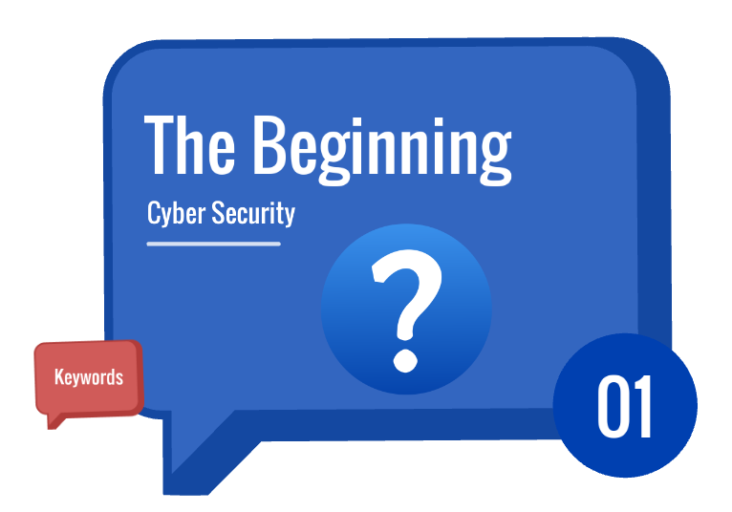
Introduction

Slide 3
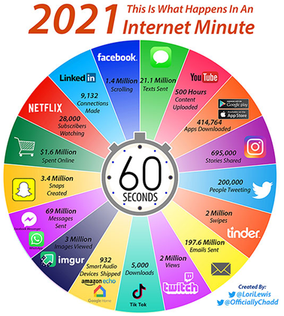
What happens online in 60 Seconds?

Slide 4
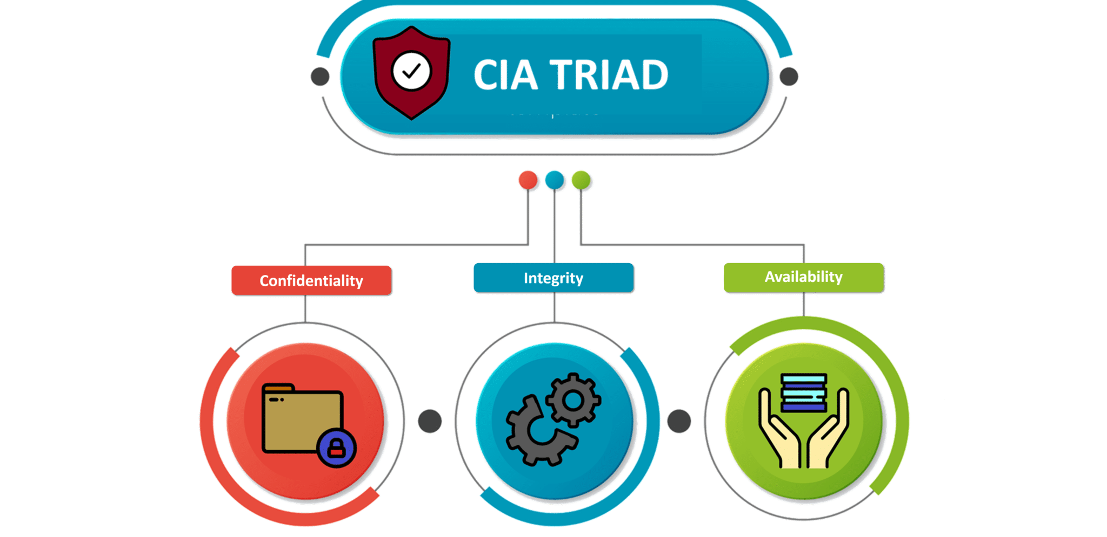
Secure Communication

Slide 5
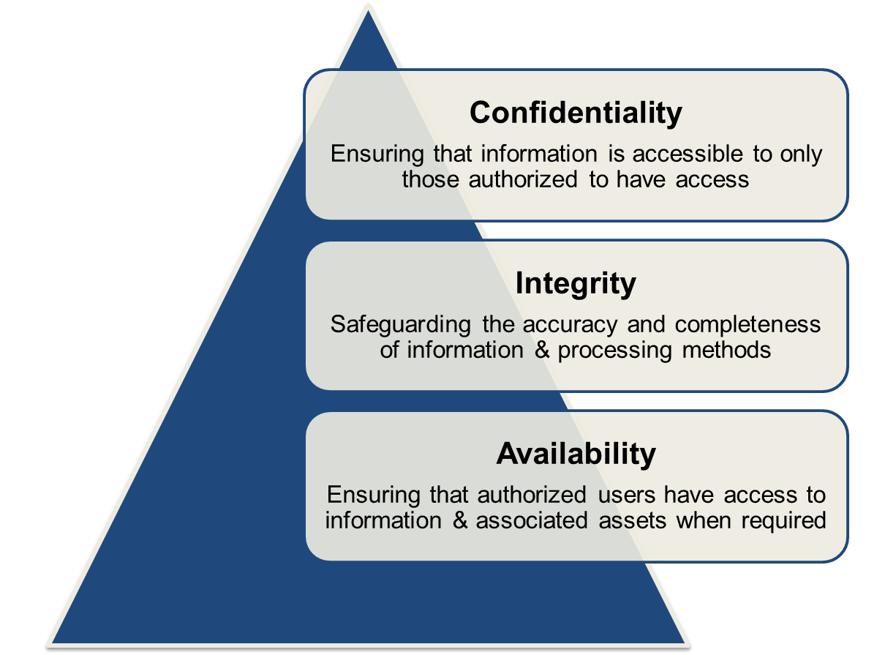
CIA

Slide 6
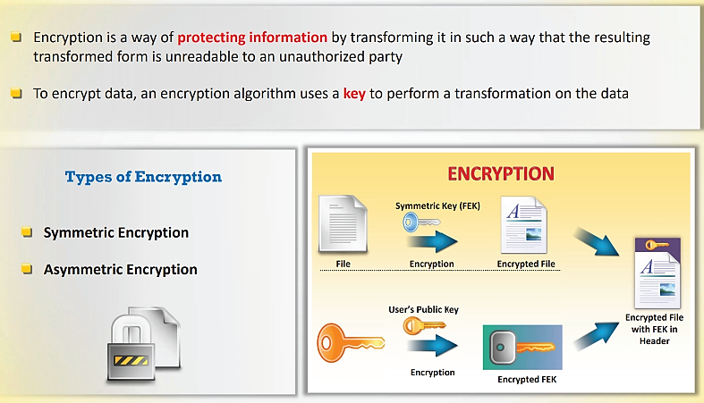
Encryption

Slide 7
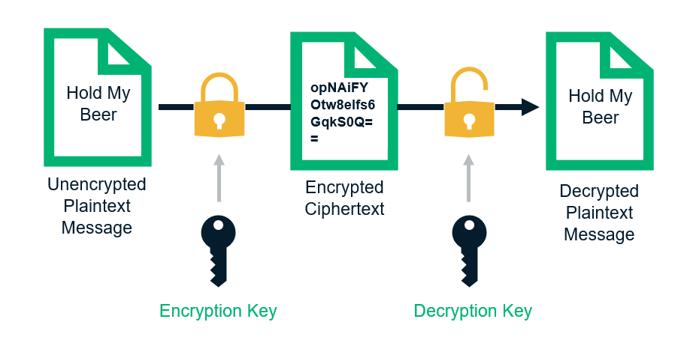
How Encryption Works?

Slide 8
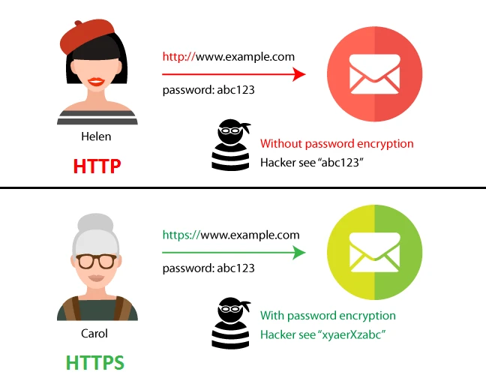
HTTP vs HTTPS

Slide 9
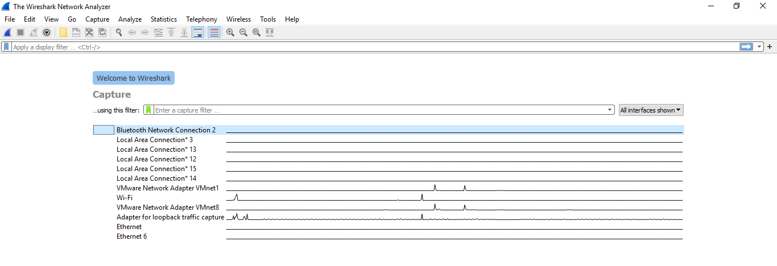
Traffic Analysis Using Wireshark

Slide 10
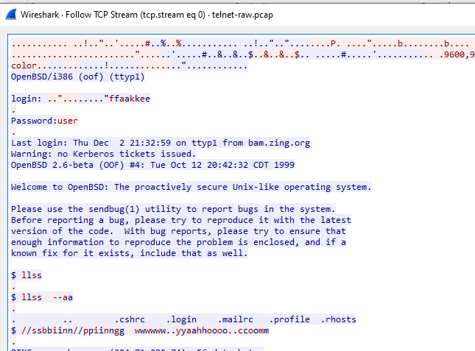
Wireshark Packet Analysis

Slide 11
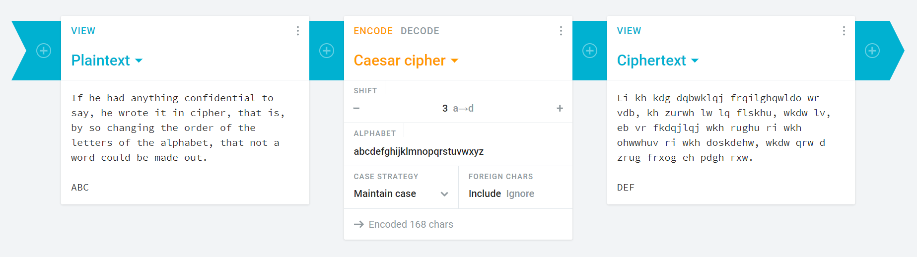
Online Crypto Tool : Cryptii

Slide 12
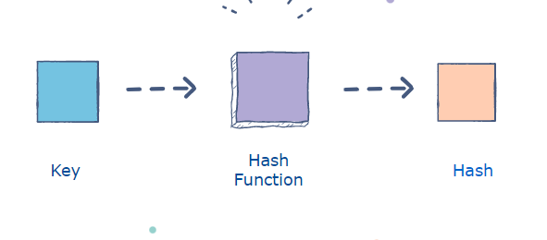
Hashing
Hashing is the process of transforming any given key or a string of characters into another value.
A hash function is used to generate the new value according to a mathematical algorithm.
The result of a hash function is known as a hash value or simply, a hash.

Slide 13
Purpose of Hashing
The purpose of hashing is:
To verify data integrity
Authentication
To store sensitive data

Slide 14
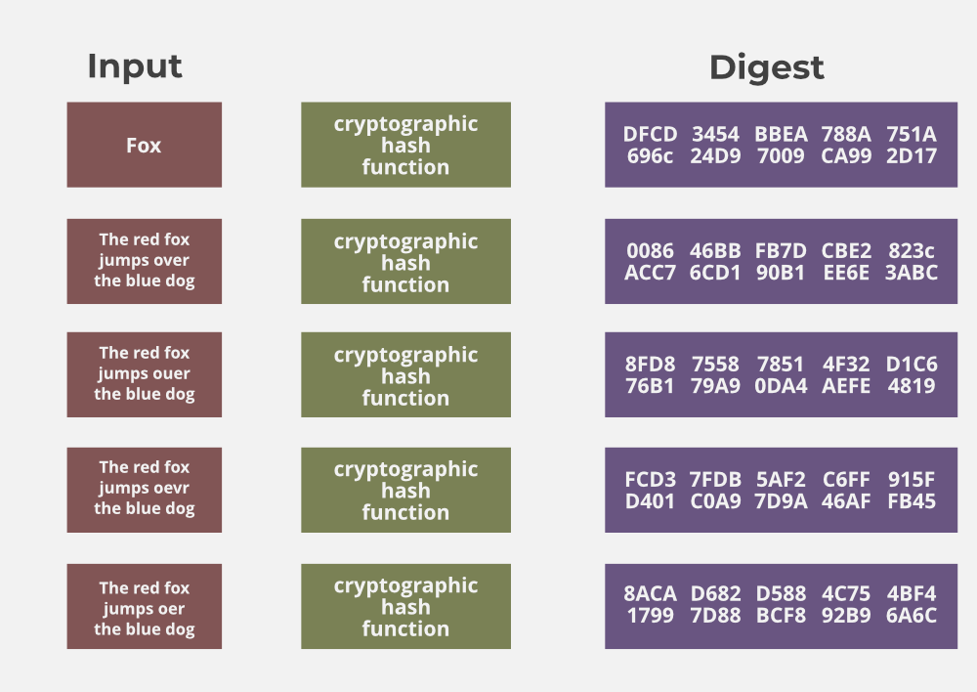
Hashing Properties

Slide 15
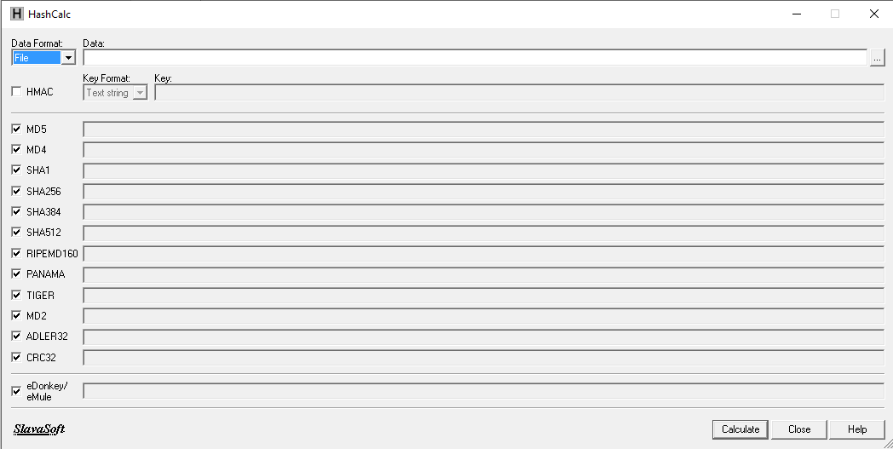
Hashcalc

Slide 16
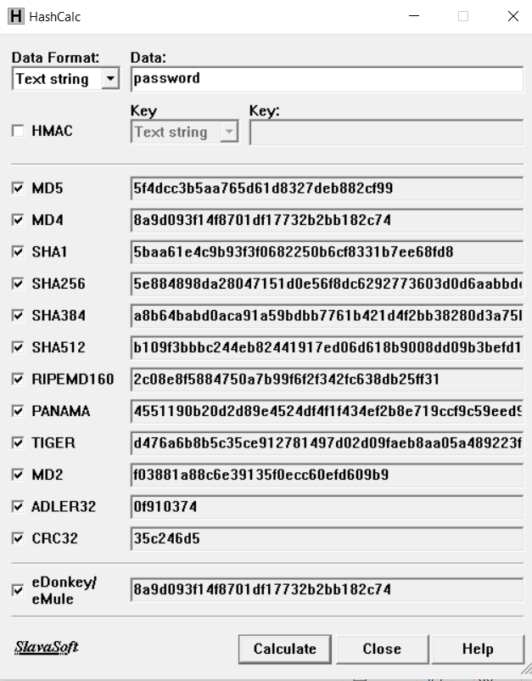
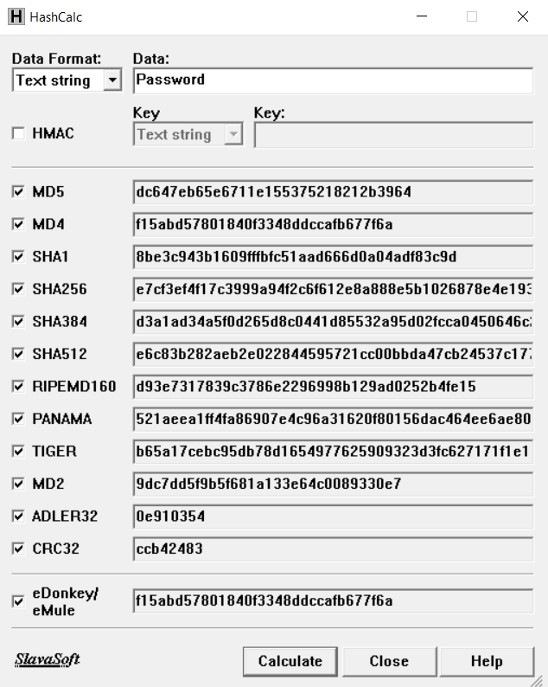

Slide 17
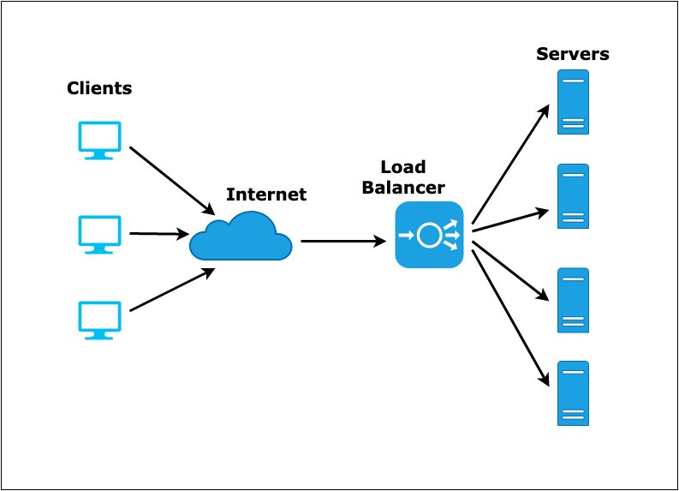
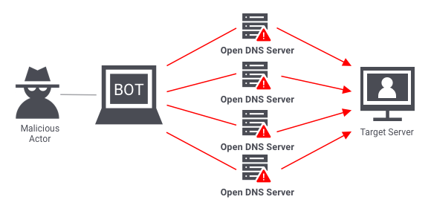
Availability

Slide 18
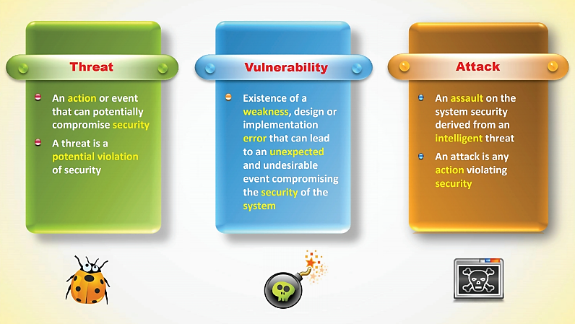
Essential Terminologies

Slide 19
Cybersecurity Threat Landscape

Slide 20
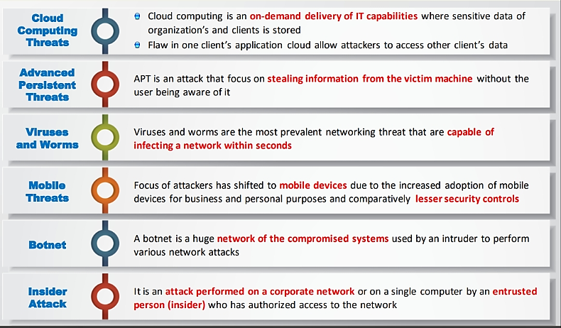
Cyber Security Attack Vectors

Slide 21
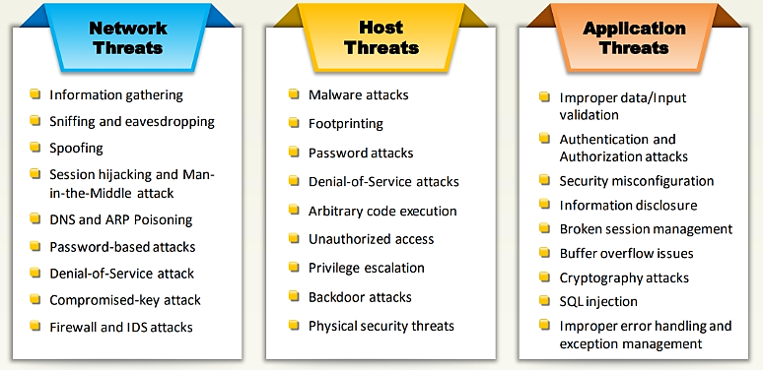
Threat Categories

Slide 22
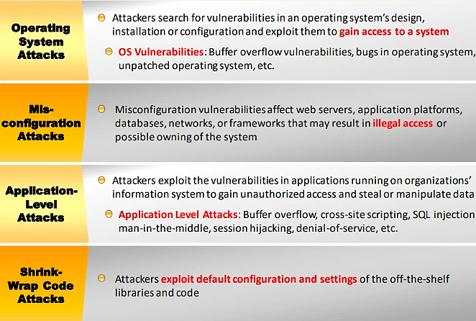
Types of attack on a system

Slide 23
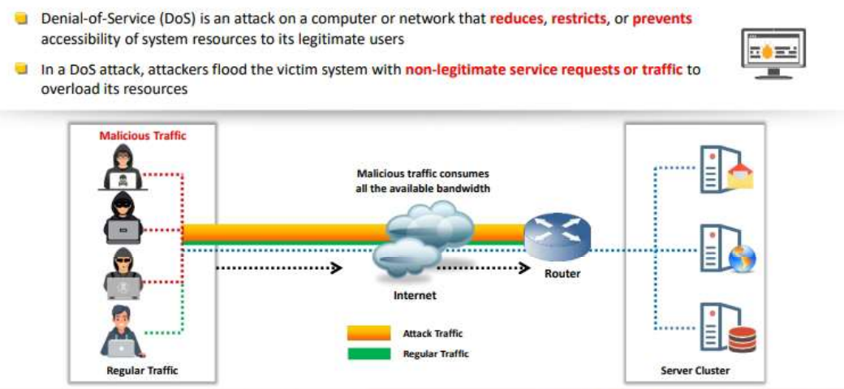
Denial-of-Service(DoS)

Slide 24
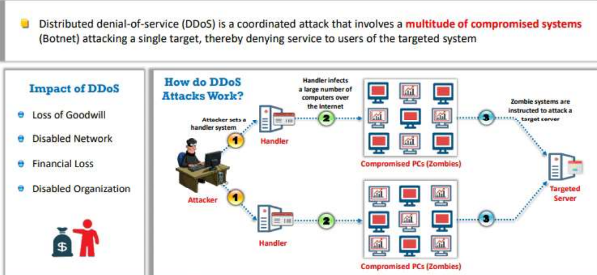
Distributed Denial-of-Service(DoS)

Slide 25
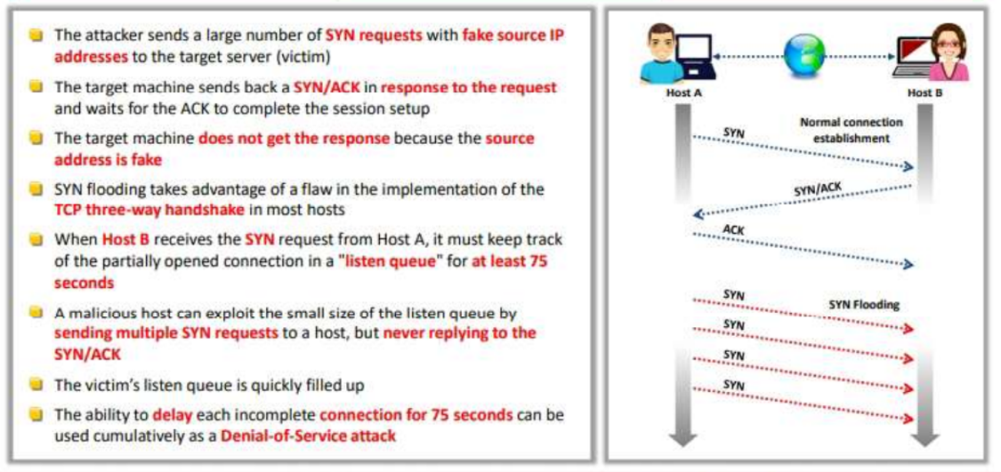
Syn Flooding

Slide 26
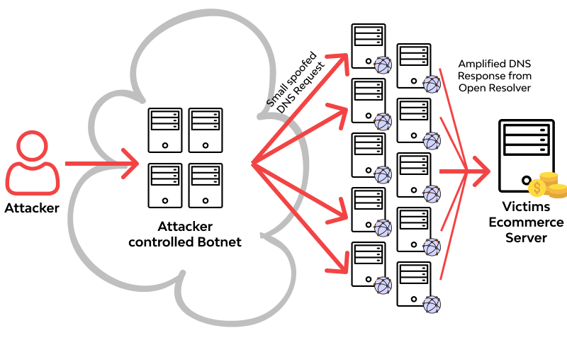
Amplification Attack

Slide 27
Amplification Attack

Slide 28
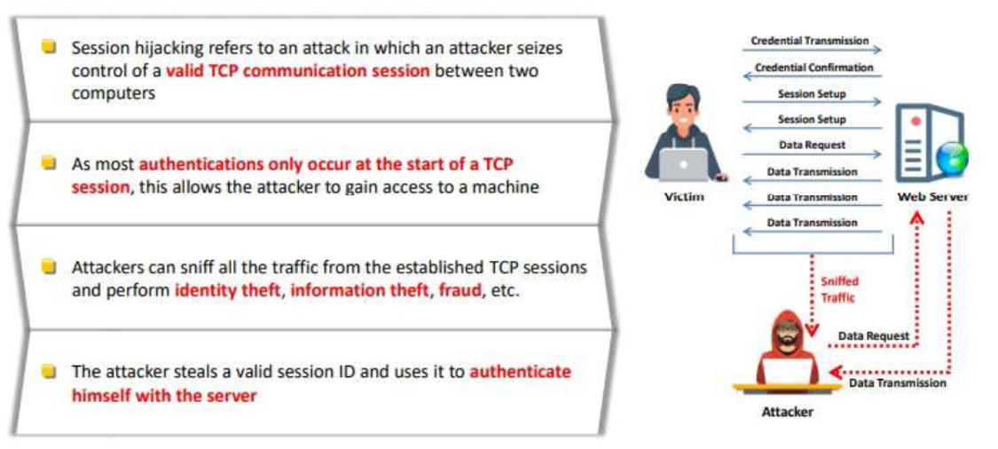
Session Hijacking

Slide 29
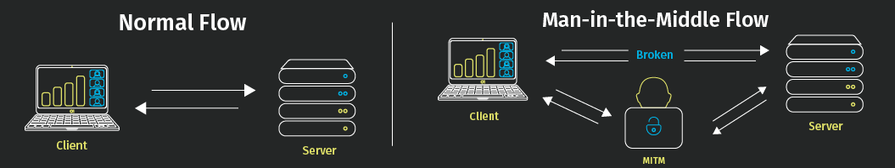
Man-in-the-Middle Attack

Slide 30
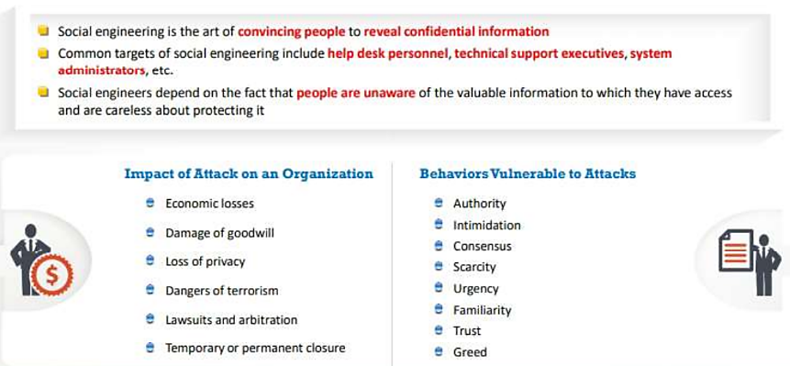
Social Engineering

Slide 31
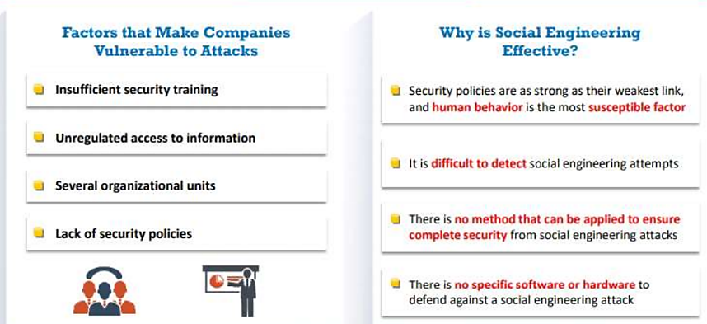
Social Engineering (Continue.,)

Slide 32
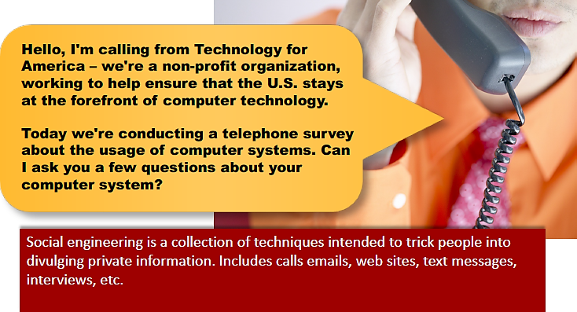
Social Engineering (Continue.,)

Slide 33
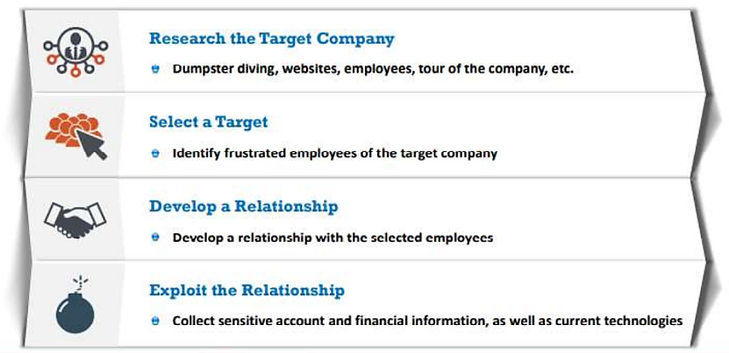
Phases of a Social Engineering Attack

Slide 34
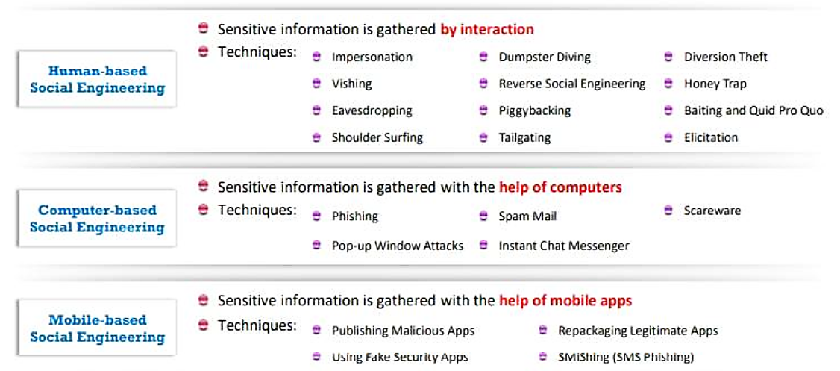
Types of Social Engineering

Slide 35
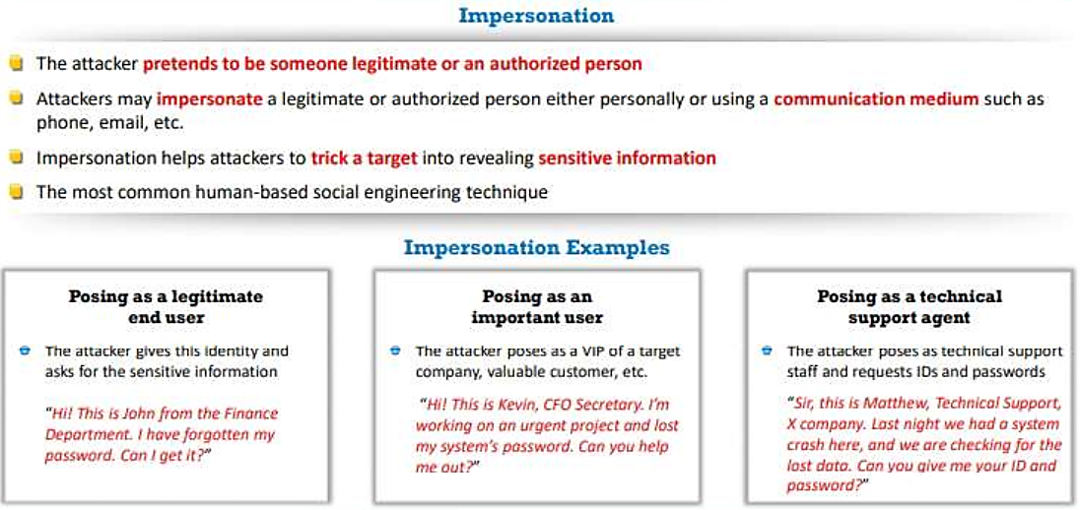
Human-based Social Engineering

Slide 36
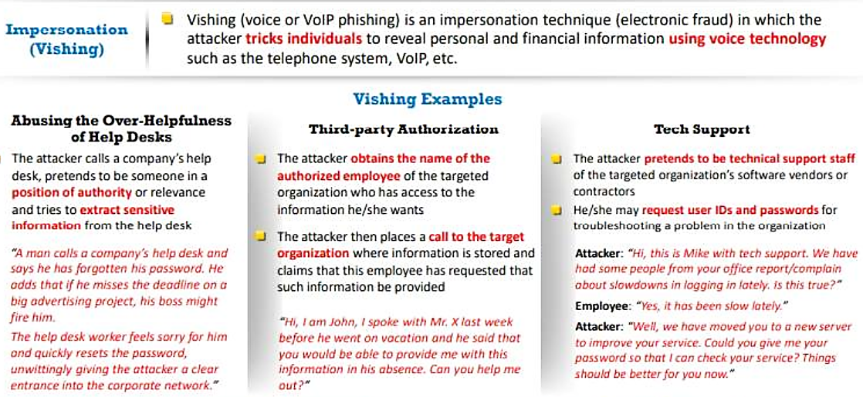
Human-based Social Engineering(Continue.,)

Slide 37
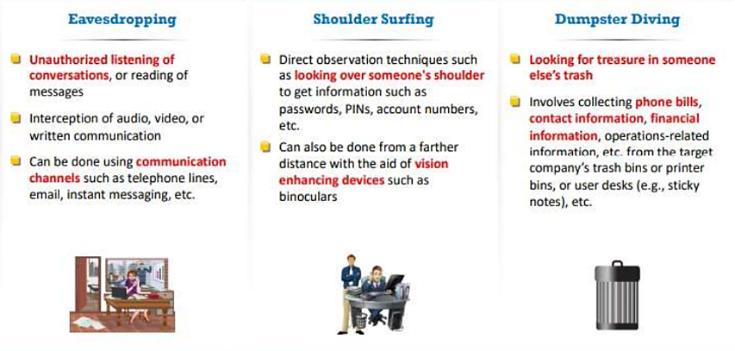
Human-based Social Engineering

Slide 38
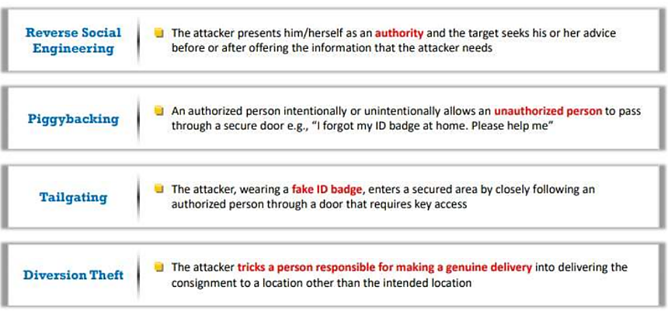
Human-based Social Engineering(Continue.,)

Slide 39
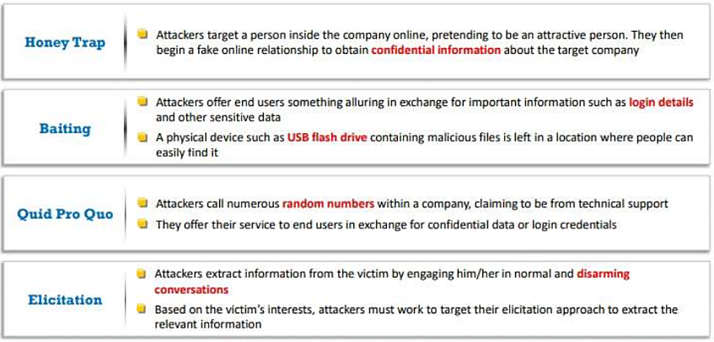
Human-based Social Engineering(Continue.,)

Slide 40
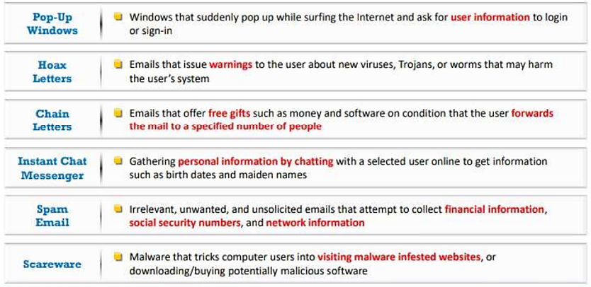
Computer-based Social Engineering

Slide 41
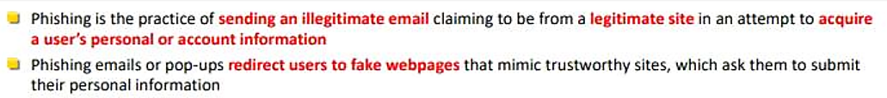
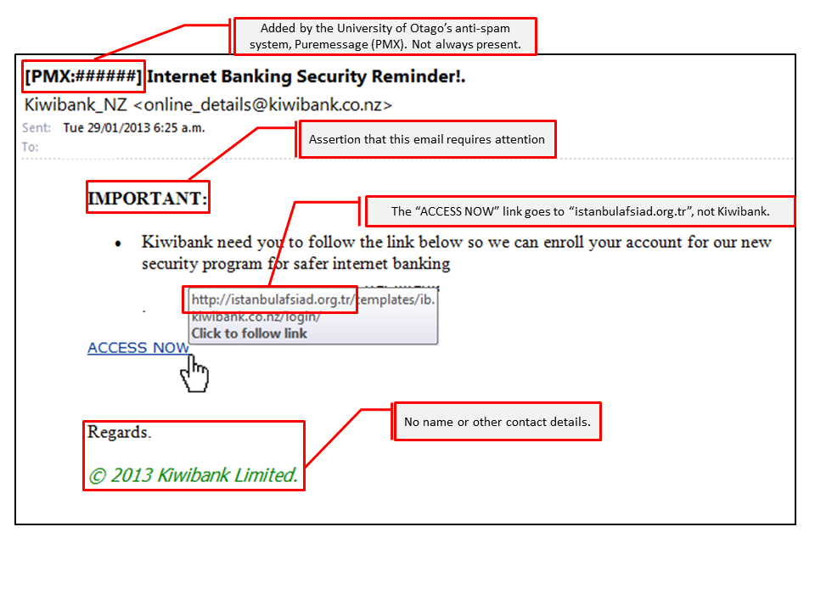
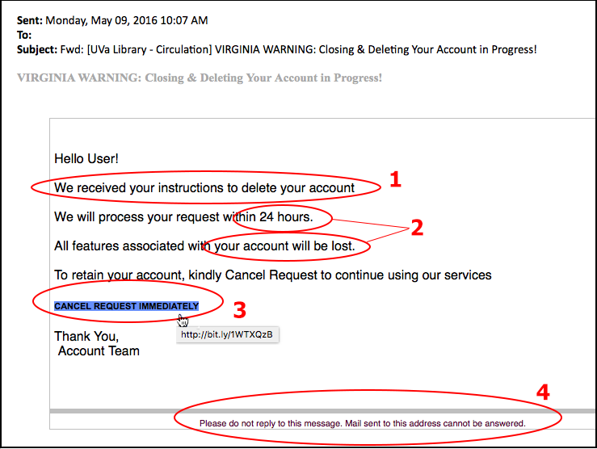
Computer-based Social Engineering : Phishing

Slide 42
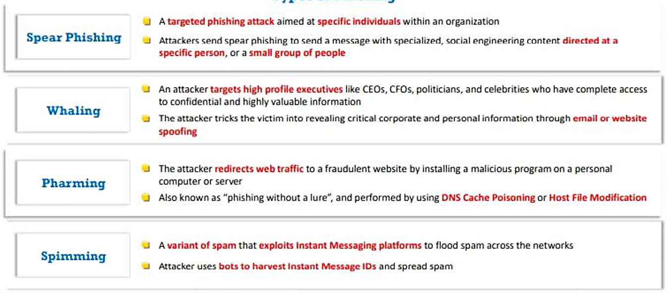
Types of Phishing

Slide 43
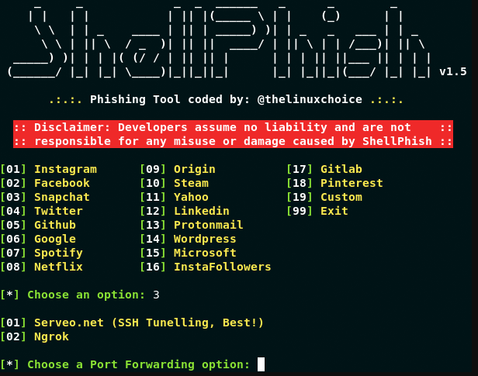
Phishing Tools
ShellPhish is a phishing tool used to phish user credentials from various social networking platforms such as Instagram, Facebook, Twitter, LinkedIn etc.

Slide 44
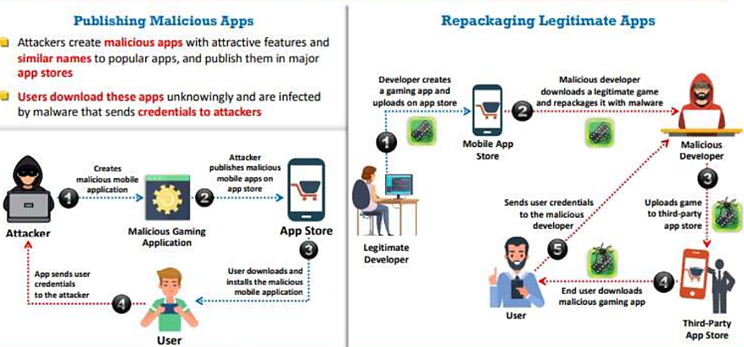
Mobile-based Social Engineering : Publishing Malicious Apps and Repackaging Legitimate Apps

Slide 45
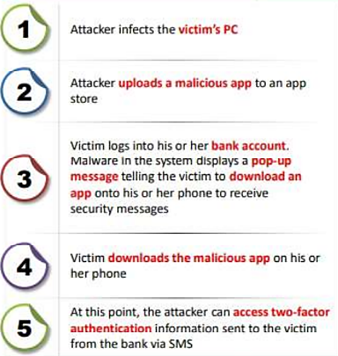
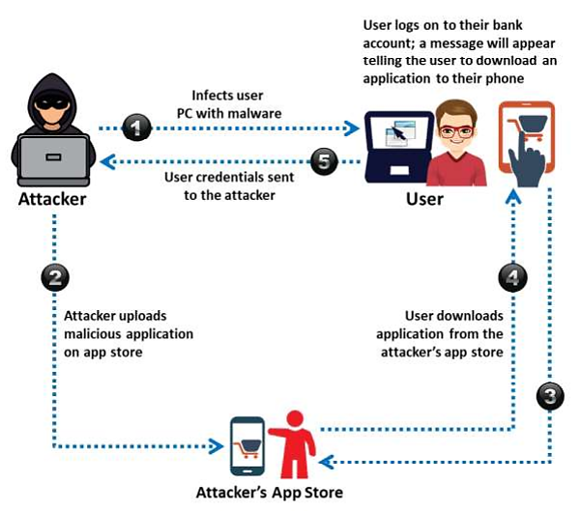
Mobile-based Social Engineering : Fake Security Applications

Slide 46
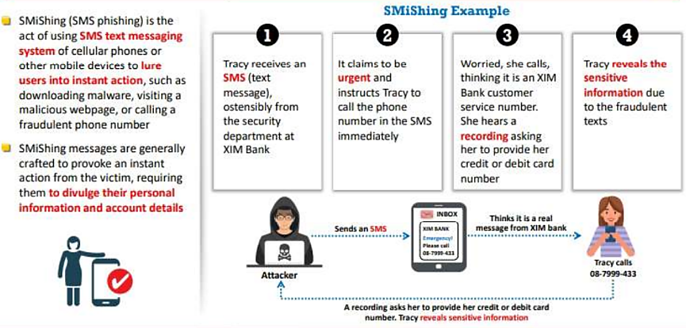
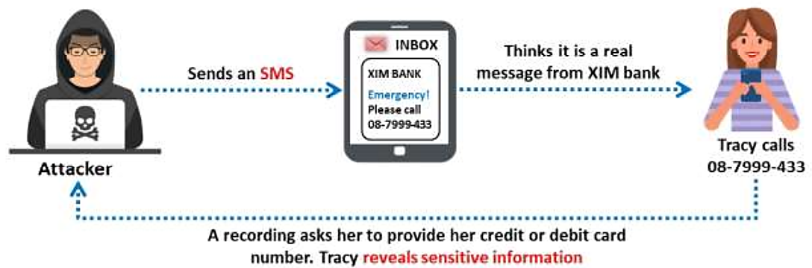
Mobile-based Social Engineering : SMishing

Slide 47
Social Engineering(Do’s & Dont’s)
Do’s
Document the situation verify the caller identity, obtain as much information as possible, if Caller ID is available, write down the caller's telephone number, take detailed notes of the conversation
Be aware of what you post online!
Monitor privacy settings
Refrain from discussing any work related matters on such sites.

Slide 48
Social Engineering (Do’s & Dont’s)
Don’t
Participate in surveys
Share personal information
Give out computer systems or network information

Slide 49
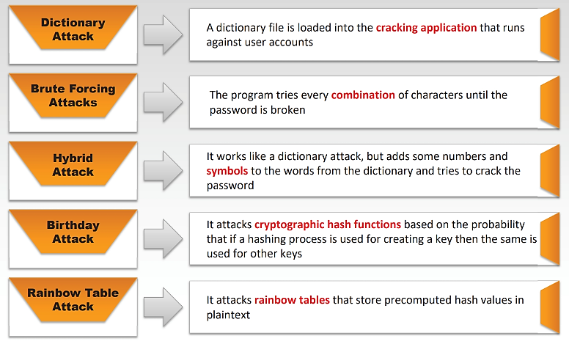
Password Attack Techniques

Slide 50
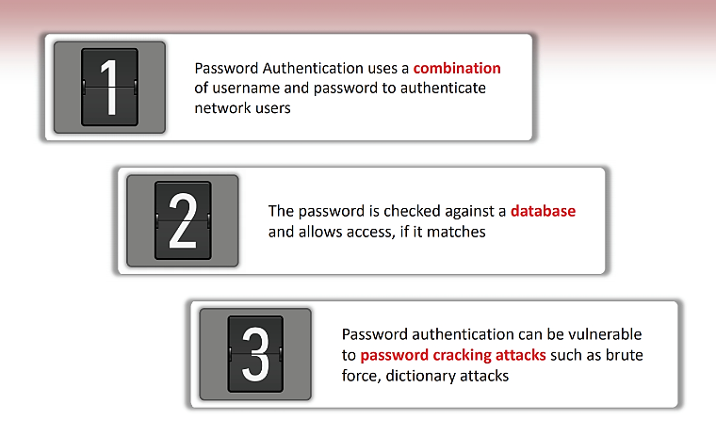
Types of Authentication : Password Authentication

Slide 51

Malware Attacks

Slide 52

Types of Authentication : Smart Card Authentication

Slide 53

Types of Authentication : Biometrics

Slide 54

Types of Authentication : Two-factor Authentication

Slide 55

Types of Authentication : Single Sign-on (SSO)

Slide 56

Physical Security

Slide 57

Factors Affecting Physical Security

Slide 58

Physical Security Controls

Slide 59

Physical Security Controls : Physical Barriers

Slide 60

Physical Security Controls : Security Personnel

Slide 61

Physical Security Controls : Authenticating Individuals with “Something You Know” Factor

Slide 62

Physical Security Controls : Authenticating Individuals with “Something You Know” Factor

Slide 63

Physical Security Controls : Authenticating Individuals with “Something You Are” Factor

Slide 64

Workplace Security : Server/Backup Device Security

Slide 65

Physical Security : Awareness/Training

Slide 66

Physical Security Checklists

Slide 67

Host Security

Slide 68

Common Threats Specific to Host Security

Slide 69

Host Assessment

Slide 70

Host Security Baselining

Slide 71

Introduction to Web Applications

Slide 72

OWASP Top 10 Web Applications Threats

Slide 73

A01:2021 – Broken Access Control

Slide 74
A02:2021 – Cryptographic Failures
Is any data transmitted in clear text? This concerns protocols such as HTTP, SMTP, FTP also using TLS upgrades like STARTTLS. External internet traffic is hazardous. Verify all internal traffic, e.g., between load balancers, web servers, or back-end systems.
Are any old or weak cryptographic algorithms or protocols used either by default or in older code?
Are default crypto keys in use, weak crypto keys generated or re-used, or is proper key management or rotation missing? Are crypto keys checked into source code repositories?

Slide 75
(Continue.,)
Is encryption not enforced, e.g., are any HTTP headers (browser) security directives or headers missing?
Is the received server certificate and the trust chain properly validated?
Are initialization vectors ignored, reused, or not generated sufficiently secure for the cryptographic mode of operation? Is an insecure mode of operation such as ECB in use? Is encryption used when authenticated encryption is more appropriate?
Are passwords being used as cryptographic keys in absence of a password base key derivation function?

Slide 76
(Continue.,)
Are deprecated hash functions such as MD5 or SHA1 in use, or are non-cryptographic hash functions used when cryptographic hash functions are needed?
Are deprecated cryptographic padding methods such as PKCS number 1 v1.5 in use?
Are cryptographic error messages or side channel information exploitable, for example in the form of padding oracle attacks?

Slide 77

A03:2021 – Injection

Slide 78


SQL Injection

Slide 79

A05:2021 – Security Misconfiguration

Slide 80

Unvalidated Inputs

Slide 81

Parameter Tampering

Slide 82

Improper Error Handling

Slide 83


A06:2021 – Vulnerable and Outdated Components

Slide 84

(Continue.,)

Slide 85
Exploit DB

Slide 86

A07:2021 – Identification and Authentication Failures

Slide 87
A08:2021 – Software and Data Integrity Failures
Software and data integrity failures relate to code and infrastructure that does not protect against integrity violations.
An example of this is where an application relies upon plugins, libraries, or modules from untrusted sources, repositories, and content delivery networks (CDNs).
An insecure CI/CD pipeline can introduce the potential for unauthorized access, malicious code, or system compromise.

Slide 88
(Continue.,)
Lastly, many applications now include auto-update functionality, where updates are downloaded without sufficient integrity verification and applied to the previously trusted application.
Attackers could potentially upload their own updates to be distributed and run on all installations.
Another example is where objects or data are encoded or serialized into a structure that an attacker can see and modify is vulnerable to insecure deserialization.

Slide 89

A09:2021 – Security Logging and Monitoring Failures

Slide 90
A10:2021 – Server-Side Request Forgery (SSRF)
SSRF flaws occur whenever a web application is fetching a remote resource without validating the user-supplied URL.
It allows an attacker to coerce the application to send a crafted request to an unexpected destination, even when protected by a firewall, VPN, or another type of network access control list (ACL).
As modern web applications provide end-users with convenient features, fetching a URL becomes a common scenario.
As a result, the incidence of SSRF is increasing. Also, the severity of SSRF is becoming higher due to cloud services and the complexity of architectures.

Slide 91

(Continue.,)

Slide 92

Other Web Application Threats

Slide 93

Secure coding practices

Slide 94

Secure coding practices

Slide 95

Types of Testing

Slide 96

Penetration testing and vulnerability scanning

Slide 97

Fuzz testing

Slide 98
Thank You!!!

